Slide 1
self-driving car technology introduction
Hauptseminar
Hu Xi
12.07.2018

Slide 2
Contents of this presentation
1. Motivation
2. Methods
2.1 road lane detection
2.2 collision avoidance
3. Summary
4. Future work

Slide 3
Motivation

Slide 4
Motivation
Necessity :
• to prevent from traffic accidents
• to help people with disabilities
Possibility:
• the development of deep learning technology
• the improvement of computing power

Slide 5
Method: road lane detection

Slide 6
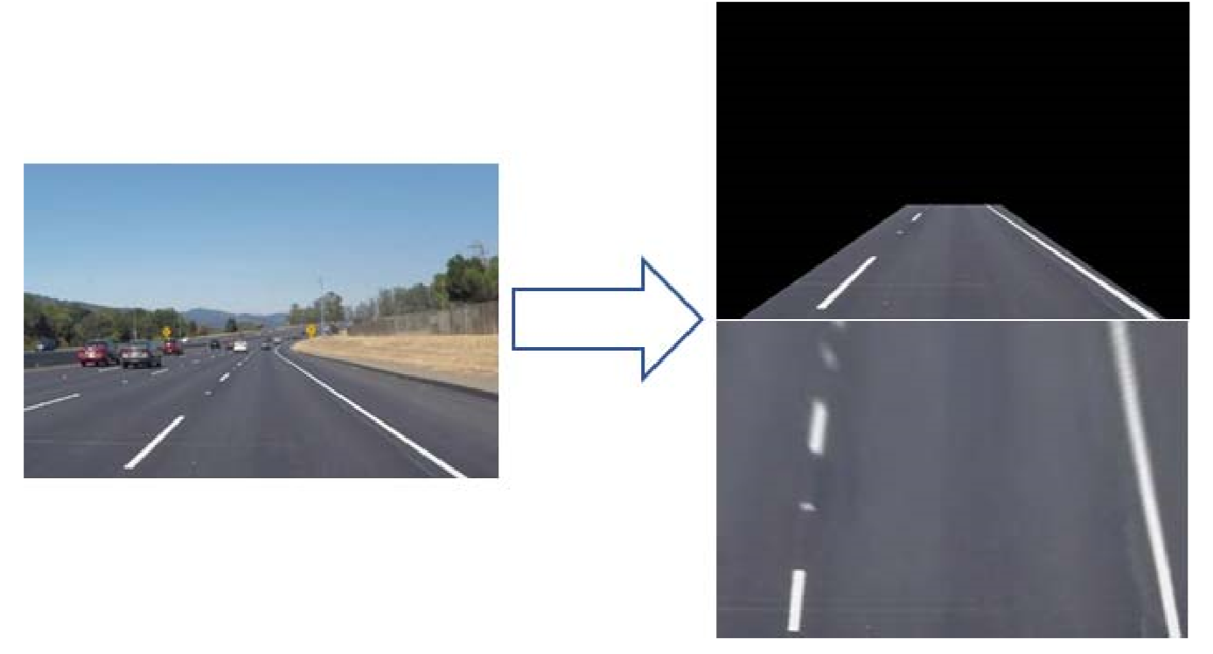
Method: road lane detection
1) image warping process and polynomial regression
a) changing the perspective
Source: Nugraha et al.[1]

Slide 7
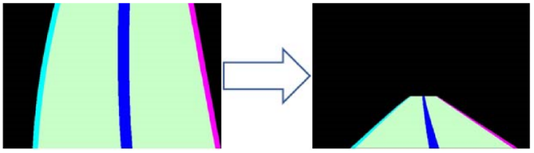
Method: road lane detection
b) approximating the lane with polynomial regression
Source: Nugraha et al.[1]

Slide 8
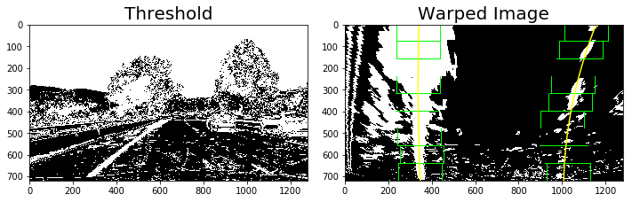
Method: road lane detection
problem: too much noise
a possible solution: segment the objects in images

Slide 9
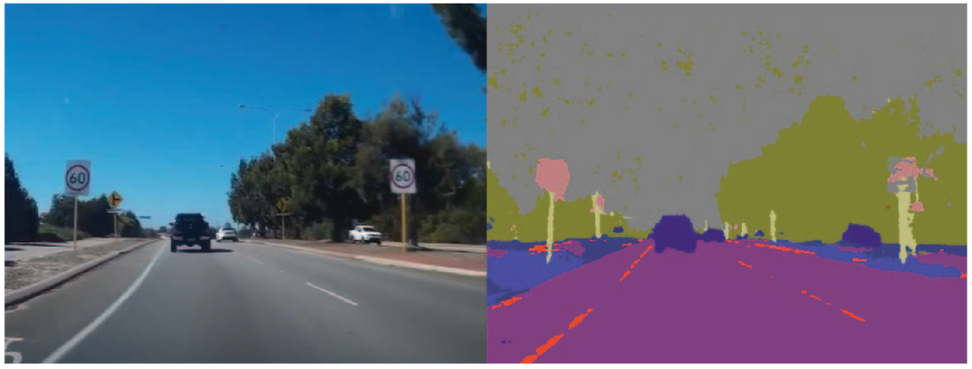
Method: road lane detection
2) SegNet (segmenting network)
a) aim: improving the accuracy of lane detection
Source: Lim et al.[2]

Slide 10
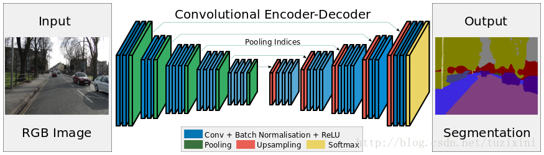
Method: road lane detection
b) a deep convolutional encoder-decoder architecture
Source: Badrinarayanan et al.[3]

Slide 11
Method: collision avoidance

Slide 12
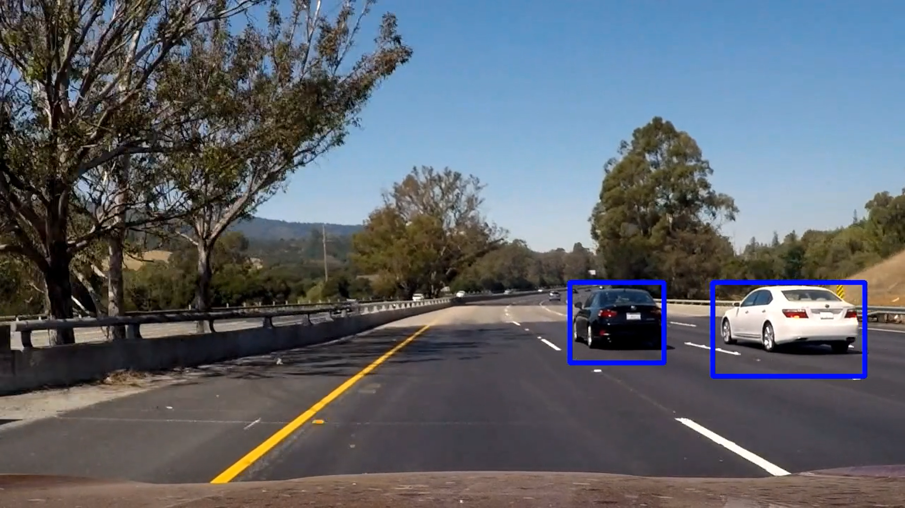
Method: collision avoidance
1) YOLO network (“you only look once” network)
a) aim: real-time object detection

Slide 13
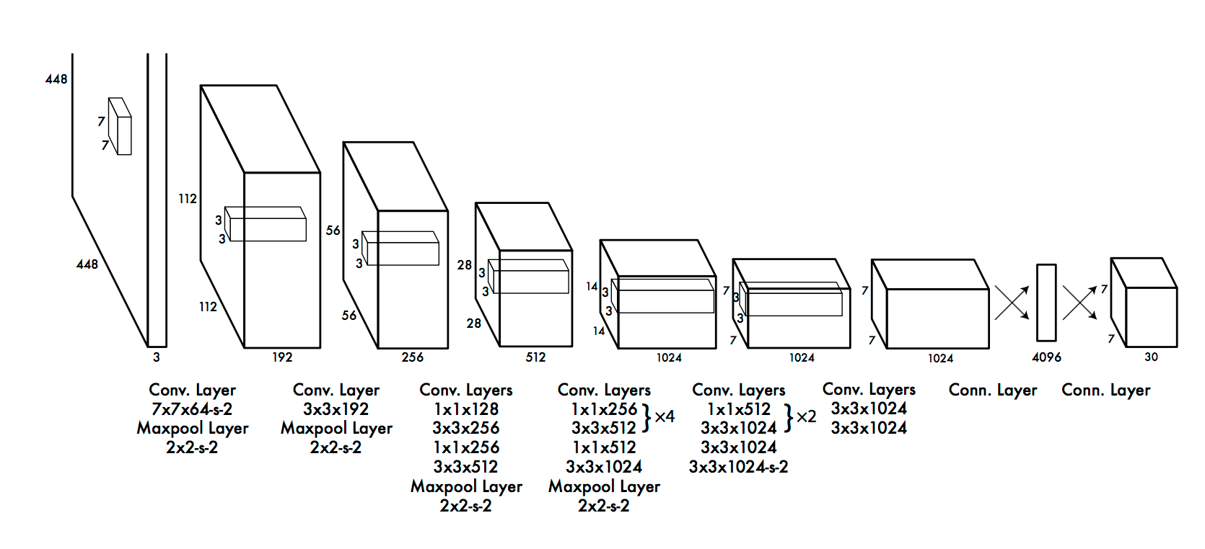
Method: collision avoidance
b) a convolutional neural network architecture
Source: Nugraha et al.[1]

Slide 14
Method: collision avoidance
2) LIDAR (light detection and ranging)
a) working principle : time of flight method
b) measuring the relative distance between the other vehicles and the self-driving car
c) constructing a so-called point cloud map
drawing a 3D environment map
d) better way to detect vehicles, but too expensive

Slide 15
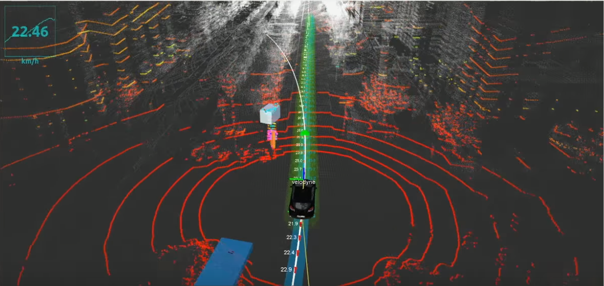
Method: collision avoidance
Source: udacity’s self driving car course

Slide 16
Method: collision avoidance
3) path planning: artificial potential field
a) assumption: the self-driving car is moving under
a virtual potential field
b) initial point: the higher “mountain head”
target point: the “mountain foot”
c) principle: repulsions of obstacles against the car

Slide 17
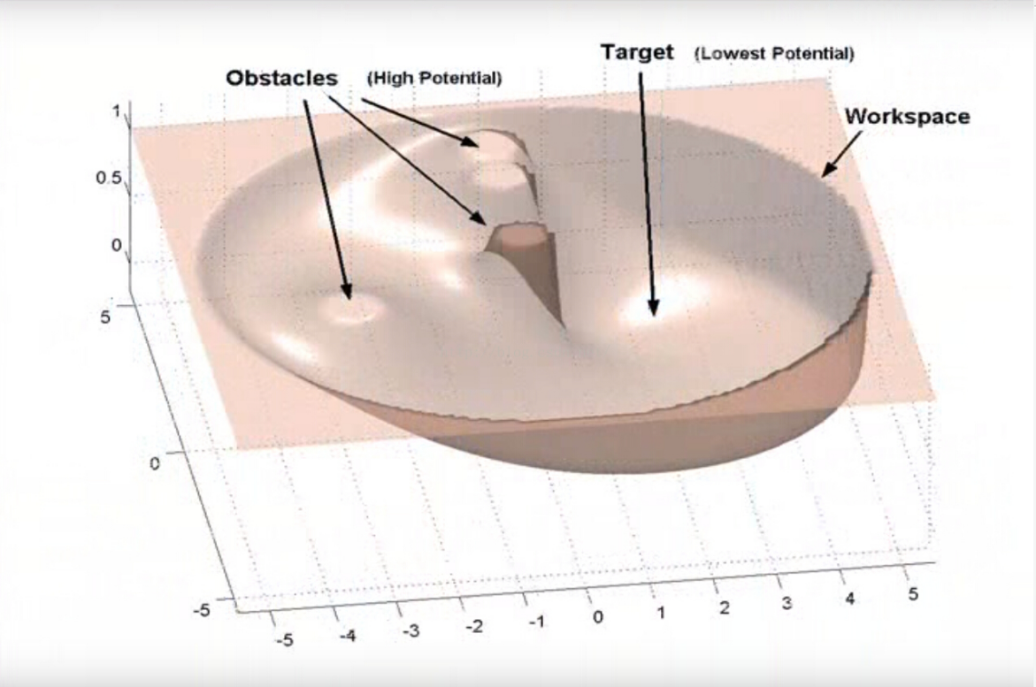
Method: collision avoidance
an example for an artificial potential field :
Source: junshen’s blog [6]

Slide 18
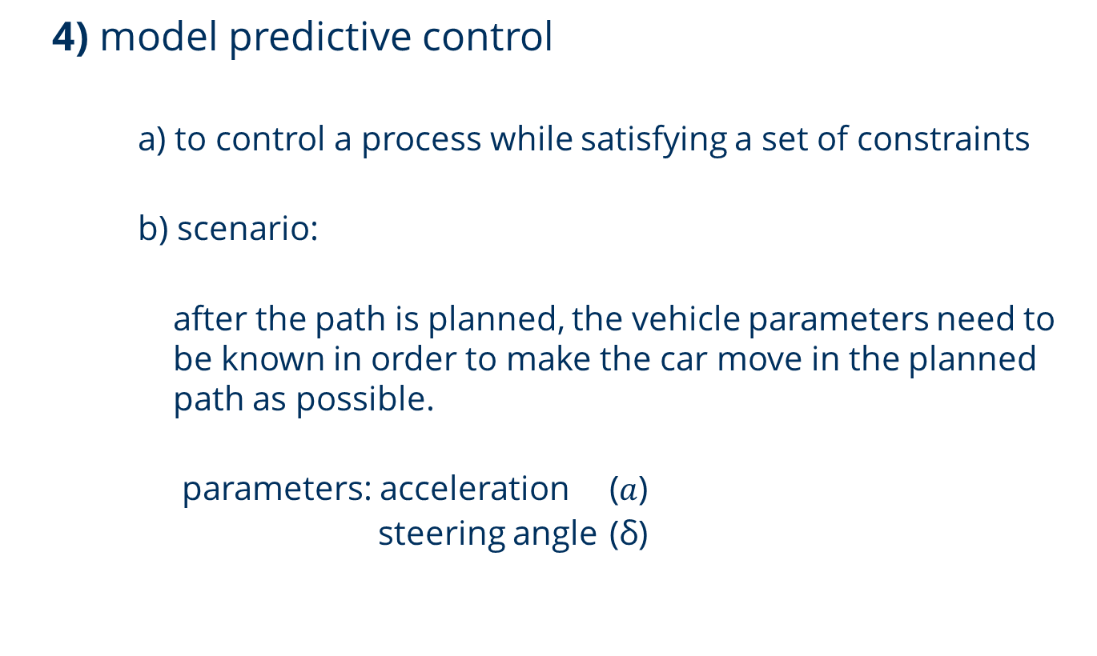
Method: collision avoidance
4) model predictive control
a) to control a process while satisfying a set of constraints
b) scenario:
after the path is planned, the vehicle parameters need to be known in order to make the car move in the planned path as possible.
parameters: acceleration ($a$)
steering angle (δ)

Slide 19
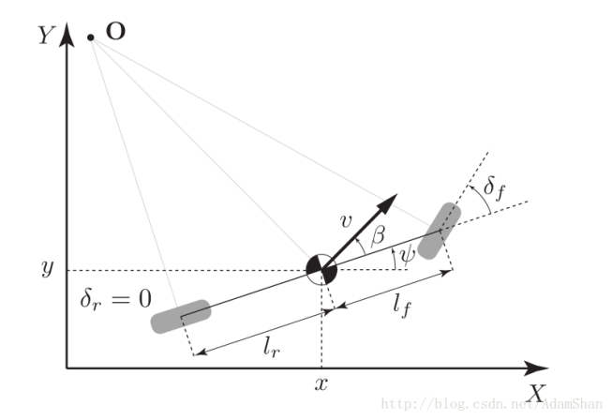
Method: collision avoidance
c) vehicle kinematic model
Source: AdamShan’s blog [5]

Slide 20
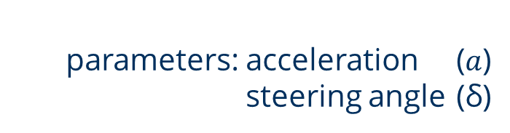
Method: collision avoidance
d) measuring and minimizing the difference between actual driving path and reference path with a loss function:
e) obtaining control parameters
dealing with environmental noise automatically
parameters: acceleration ($a$)
steering angle (δ)

Slide 21
Summary

Slide 22
Summary
• using SegNet and regression to detect the lanes
• using the YOLO algorithm and LIDAR to detect the vehicles
• using artificial potential fields to plan a path to avoid collisions
• using model predictive control to control the car on the path

Slide 23
Future work

Slide 24
Future work
1. sensor control and fusion
2. positioning and navigation
prerequisite: complementary capabilities of different sensors
aim: providing higher redundancy
aim: obtaining the exact location of the vehicle
drawing high-precision maps for path planning

Slide 25
Thank you for attention

Slide 26
Reference
[1] Nugraha B T, Su S F. Towards self-driving car using convolutional neural network and road lane detector[C]//Automation, Cognitive Science, Optics, Micro Electro-Mechanical System, and Information Technology (ICACOMIT), 2017 2nd International Conference on. IEEE, 2017: 65-69.
[2] Lim K L, Drage T, Brä T. Implementation of semantic segmentation for road and lane detection on an autonomous ground vehicle with LIDAR[C]//Multisensor Fusion and Integration for Intelligent Systems (MFI), 2017 IEEE International Conference on. IEEE, 2017: 429-434.
[3] Badrinarayanan V, Kendall A, Cipolla R. Segnet: A deep convolutional encoder-decoder architecture for image segmentation[J]. arXiv preprint arXiv:1511.00561, 2015.
[4] Ji J, Khajepour A, Melek W W, et al. Path planning and tracking for vehicle collision avoidance based on model predictive control with multiconstraints[J]. IEEE Transactions on Vehicular Technology, 2017, 66(2): 952-964.
[5] Funke J, Brown M, Erlien S M, et al. Collision avoidance and stabilization for autonomous vehicles in emergency scenarios[J]. IEEE Transactions on Control Systems Technology, 2017, 25(4): 1204-1216.

Slide 27
Reference
[6] Blog of AdamShan : https://blog.csdn.net/adamshan/article/details/79083755
[7] Blog of junshen : https://blog.csdn.net/junshen1314/article/details/50472410
[8] Szegedy C, Liu W, Jia Y, et al. Going deeper with convolutions[C]. Cvpr, 2015.

Slide 28
Q & A

